Slide 1

THE QUIZ GAME

Slide 2
Content…
Introduction
Concept Used
Welcome Interface
Overview

Slide 3
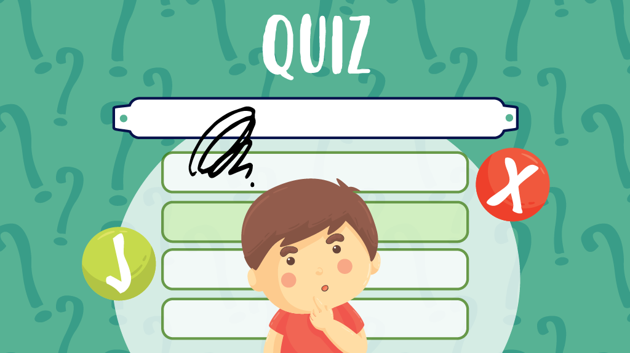
Introduction…
Consists of General Knowledge questions.
Each question with correct answer will gain 4 marks.
PLAY and CHECK your General Knowledge level.

Slide 4
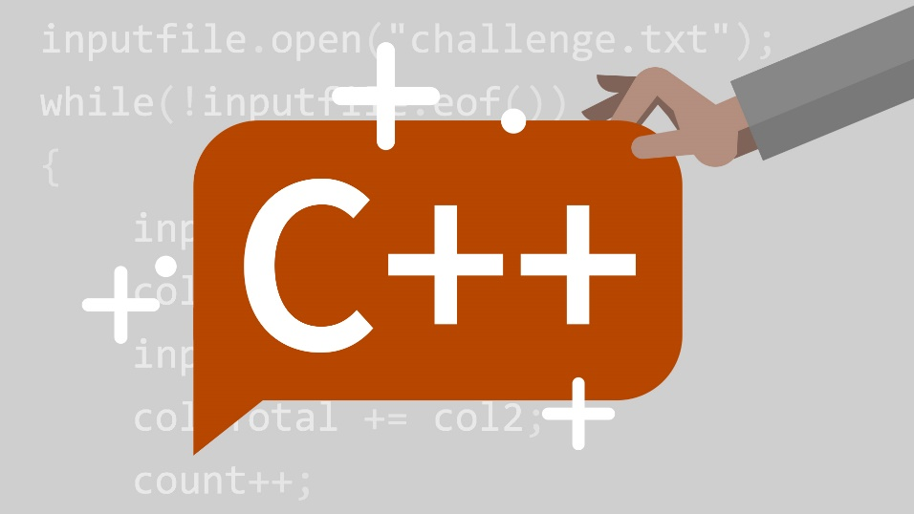
Concept Used…
Design: ASCII art generator
Made using OOP in C++ programming language.

Slide 5
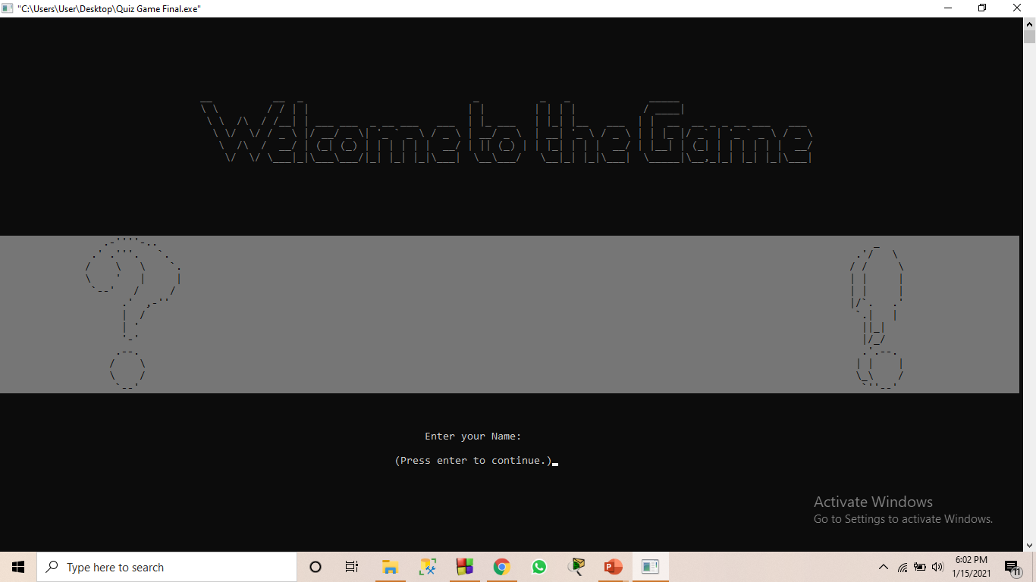
Welcome Interface
Initially the program asks for the User’s Name.

Slide 6

Menu Function
User Friendly Interface.
Main four Options :
1.Play
2.Score
3.Help
4.Exit

Slide 7
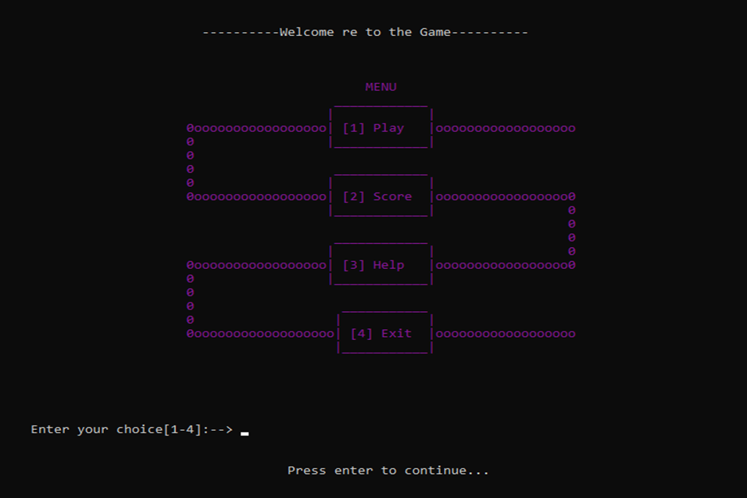
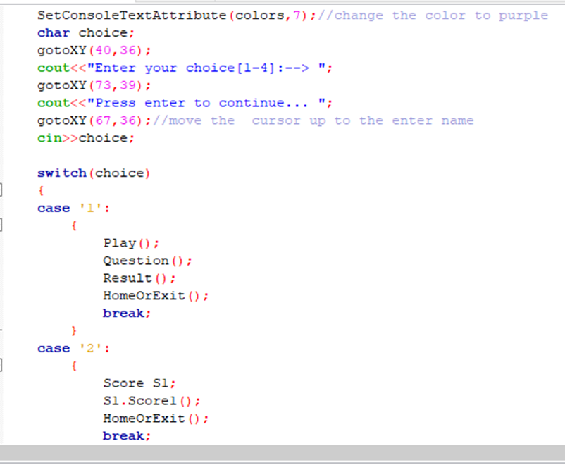

Slide 8
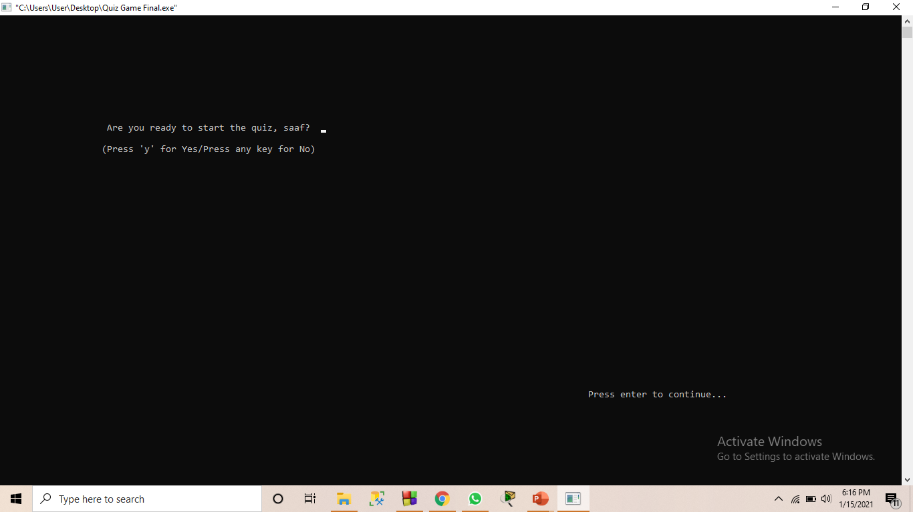
Play Option
Initially, Asks If you are ready for the game.

Slide 9
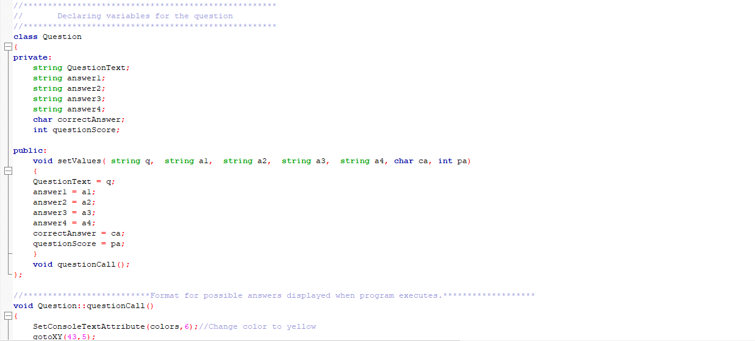
Relevant Code:

Slide 10
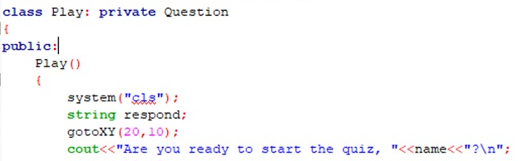
Relevant Code:

Slide 11
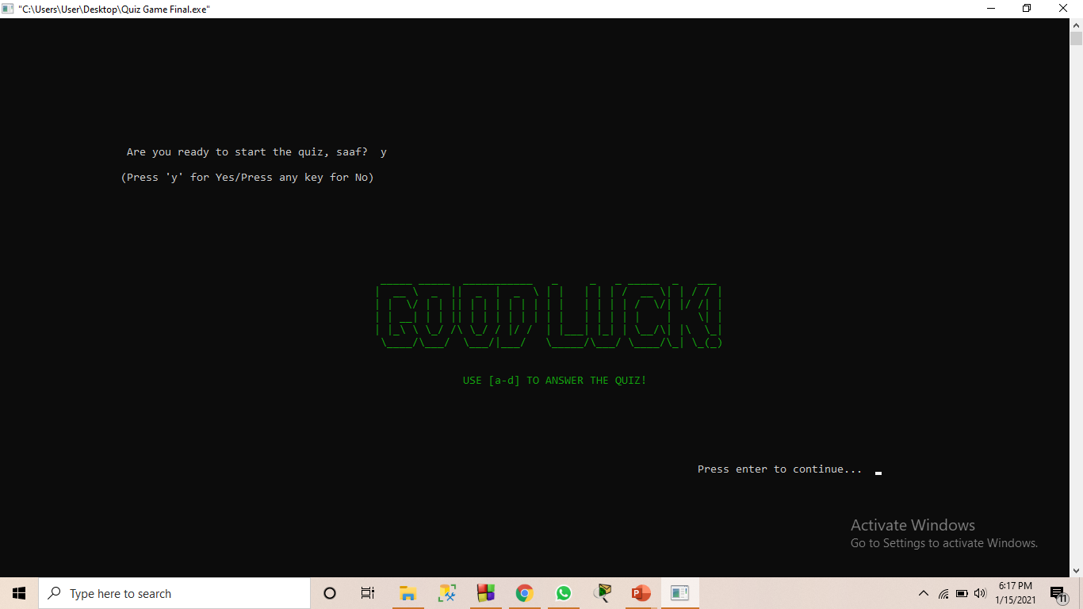
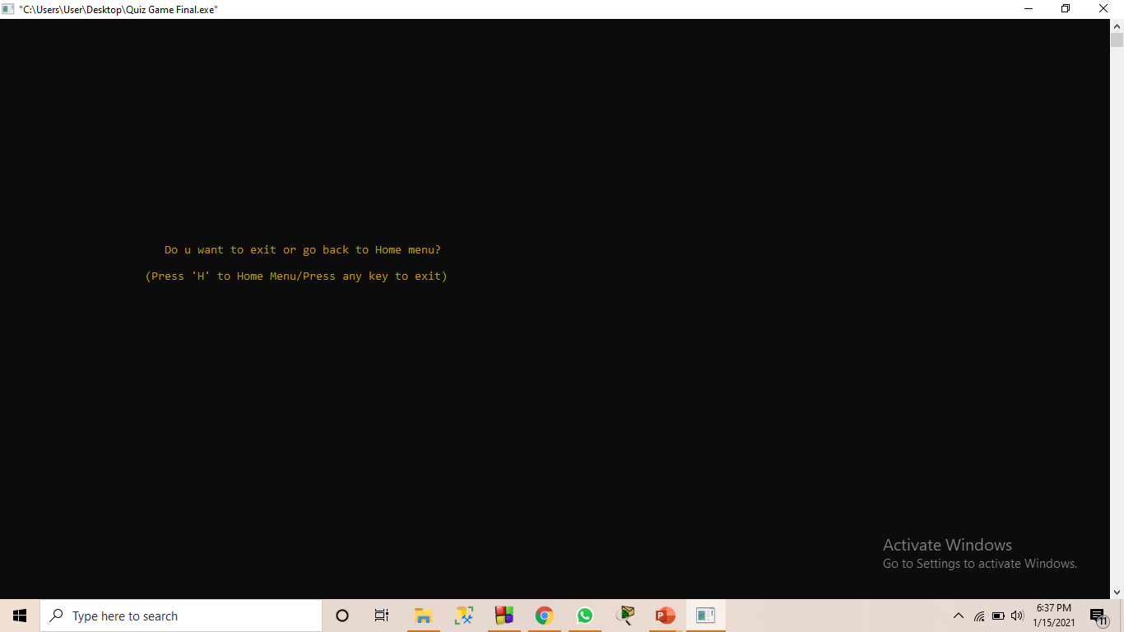
Continued…
If YES It will Display:
If NO It will Display:

Slide 12
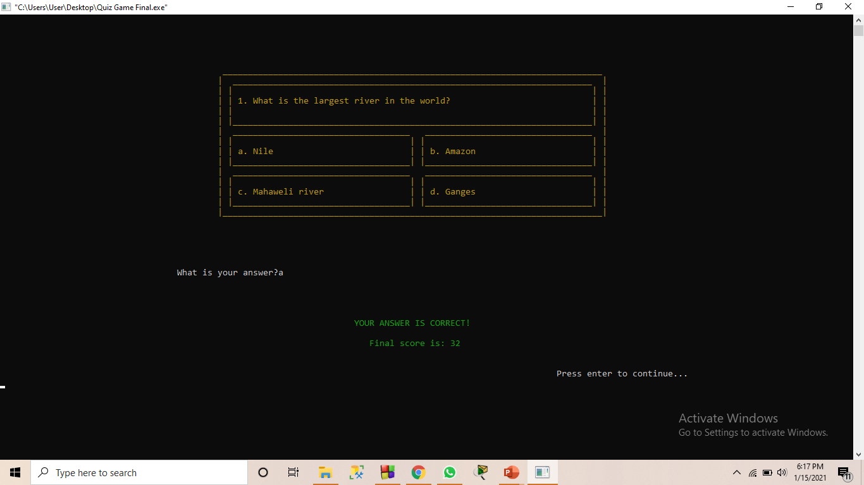
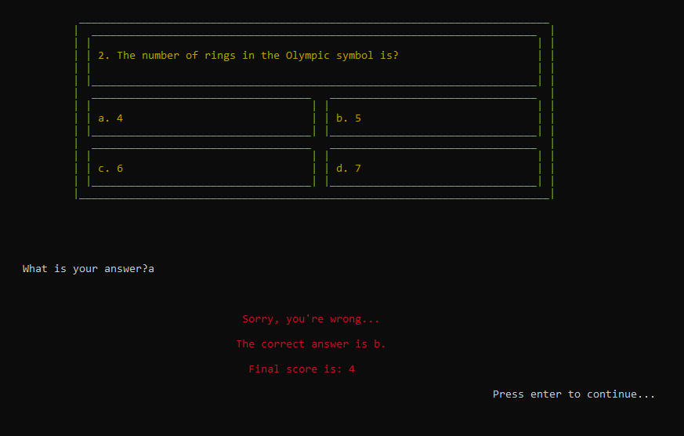
Continued…
If question CORRECT:
If question WRONG:

Slide 13
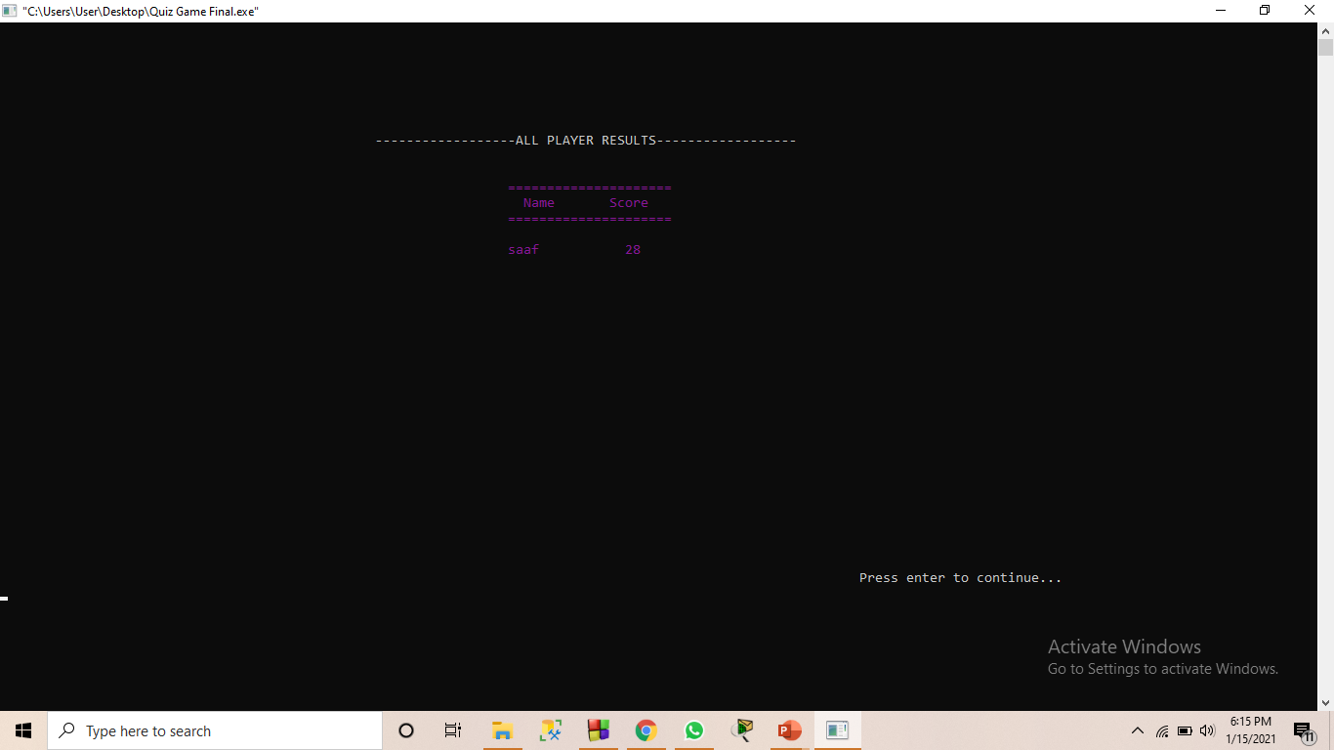
Score Option
Concept used: File-Handling

Slide 14
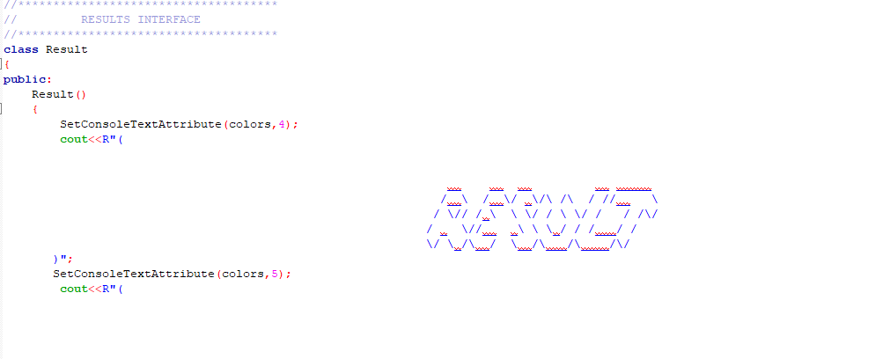
Relevant Code:

Slide 15
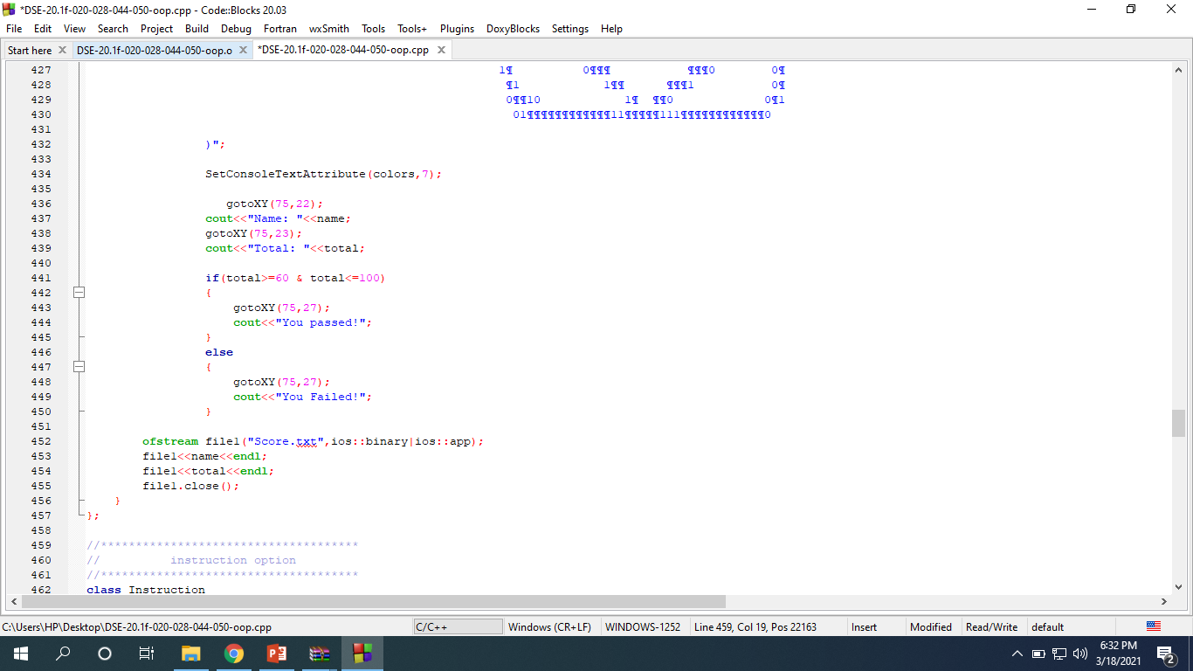
Relevant Code:

Slide 16
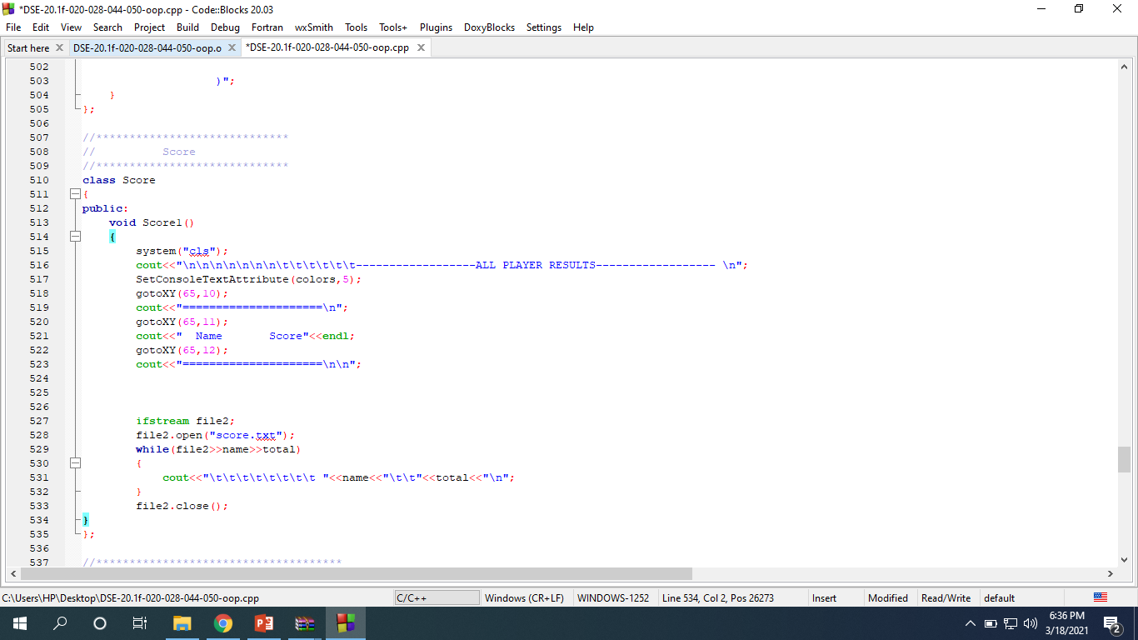
Relevant Code:

Slide 17
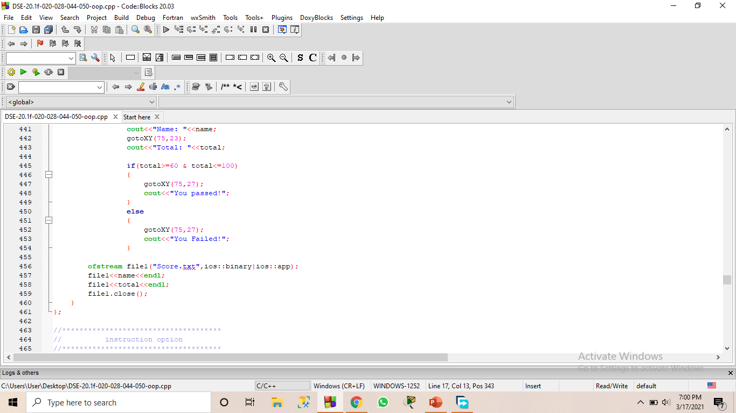
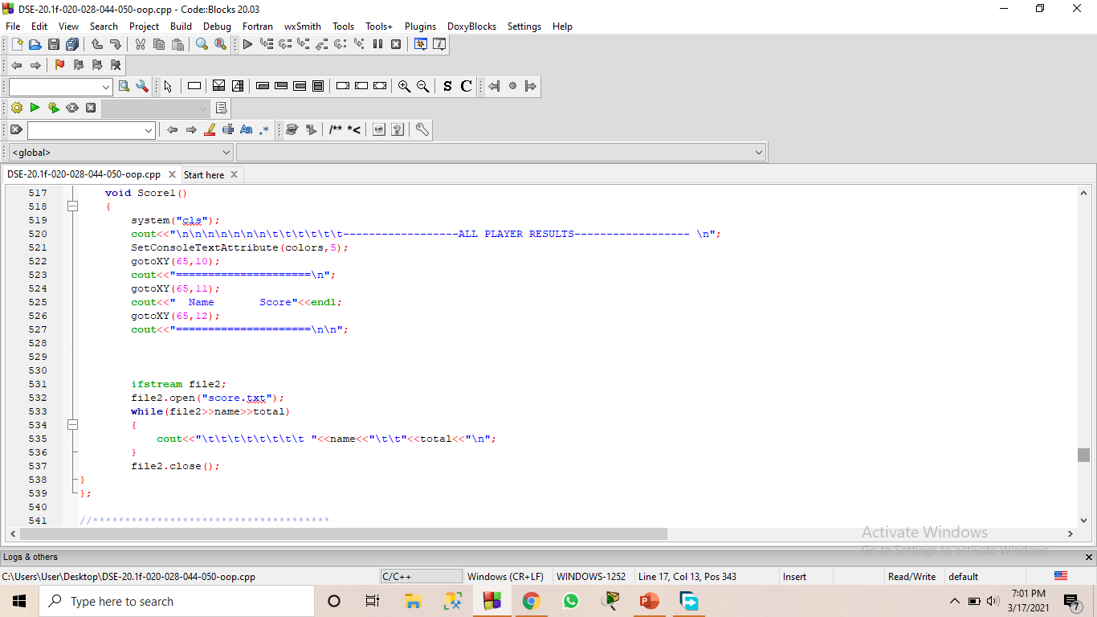
Score Option

Slide 18
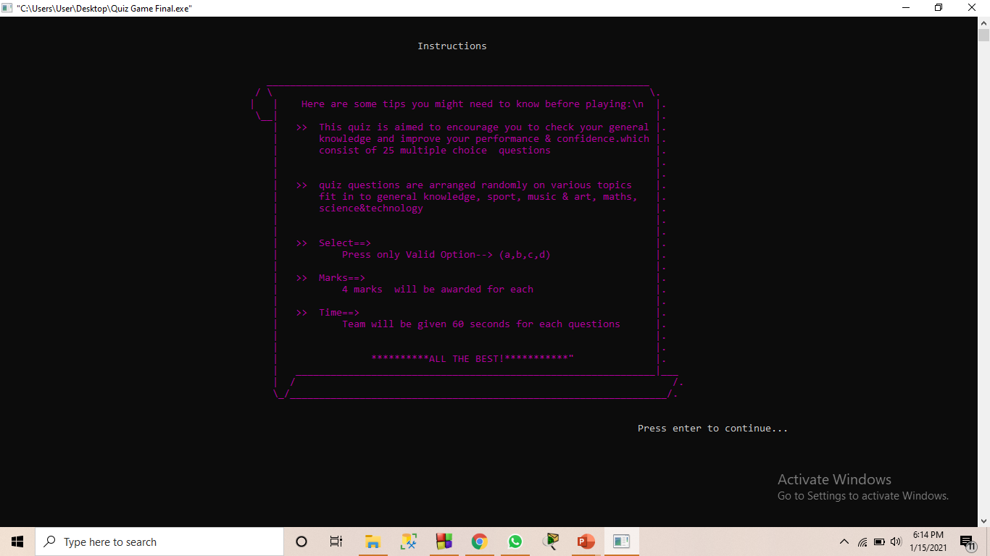
Help Option
Instructions to play the game.
25 Questions
MCQ
Each question with correct answer will gain 4 marks.

Slide 19
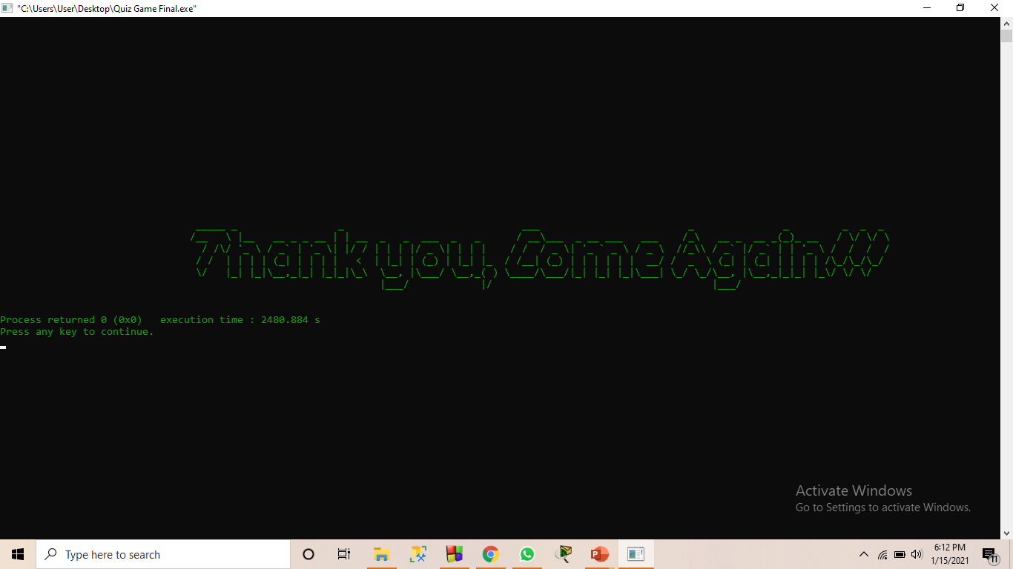
Exit Option
Leave from the game.

Slide 20
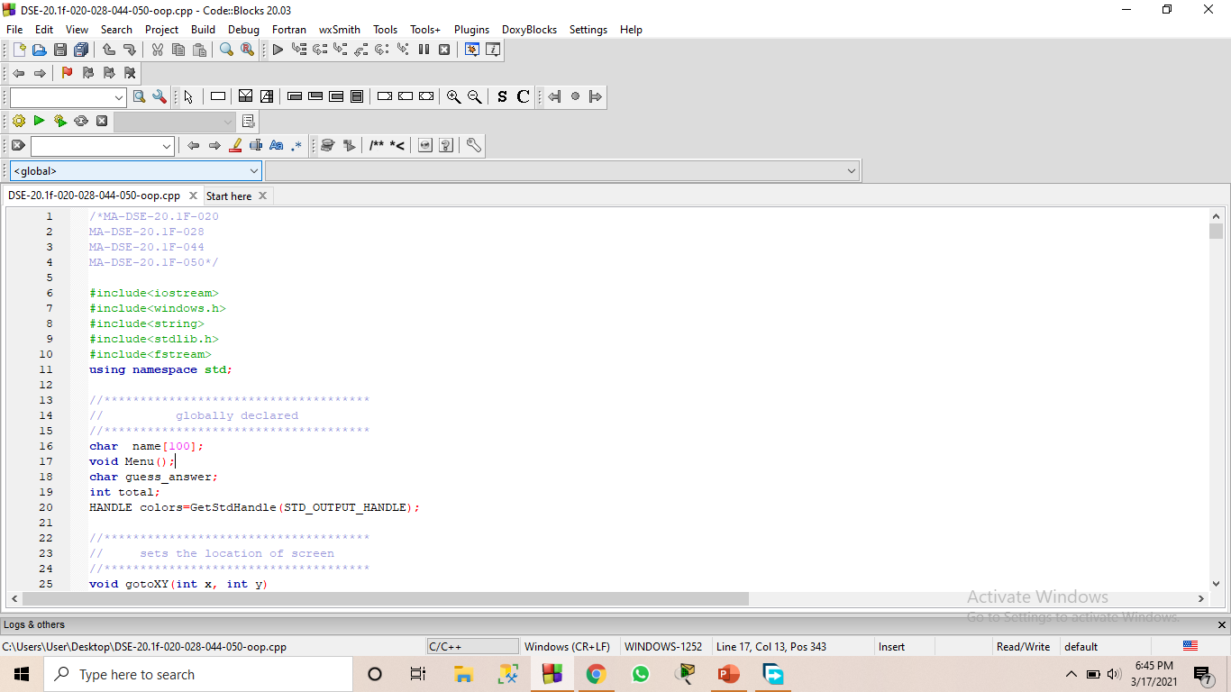
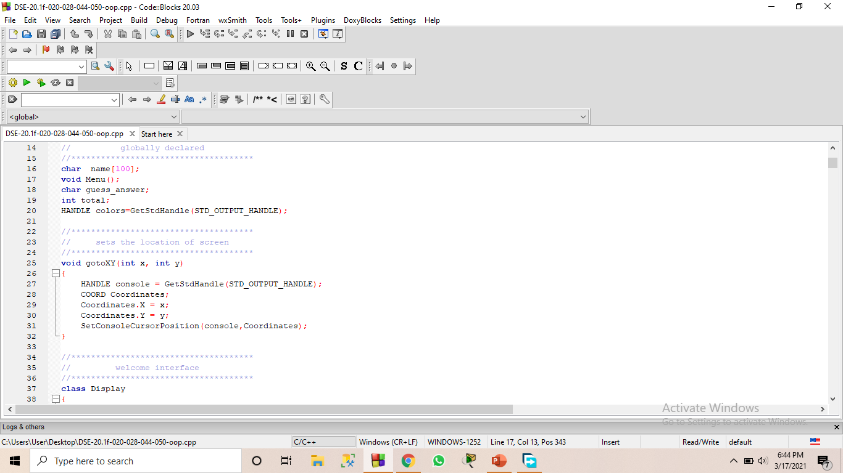
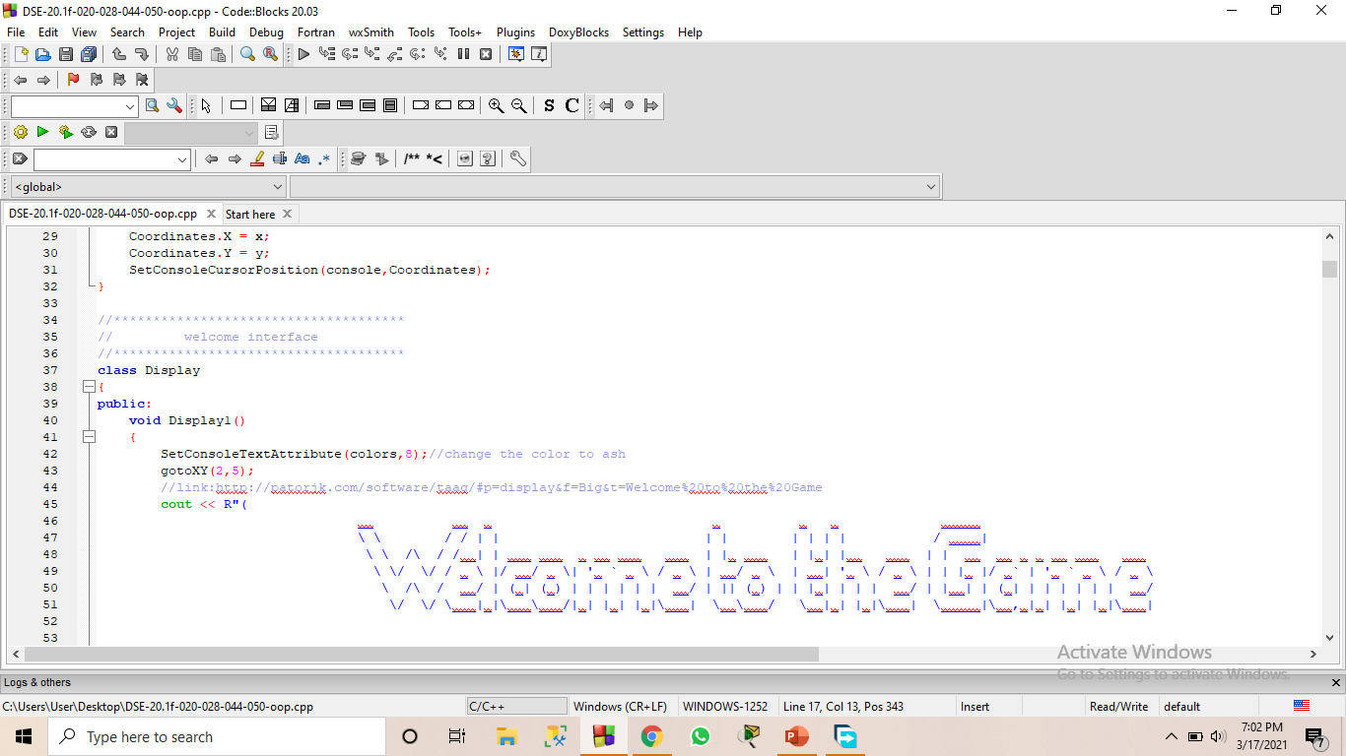
Important Things…

Slide 21

Overview
Motives user to learn something new.
To keep user updated.
Your Quest for Knowledge Will Be a Rewarding Hobby.

Slide 22

Statement of Problem…
Difficulty in adding timer.
Unable to include game levels.

Slide 23
Thank You!
MA-DSE-201-F-020
MA-DSE-201-F-028
MA-DSE-201-F-044
MA-DSE-201-F-050

